Slide 1




Health & Fitness Tracker
Empowering individuals to reach their health
and fitness goals through
personalized data tracking and visualization

Slide 2



Project Overview
Purpose
To develop a user-friendly web application that helps individuals track their daily exercise routine calories and water intake.
Target Audience
Health-conscious individuals, fitness enthuaistics, and those seeking to improve their overall well-being.

Slide 3




User Inputs and Tracking Features
Water Intake
Track daily water consumption in mililitres.
Exercise Routine
Long exercise duration, intensity
and type(e.g., cardio, strength training)
Calories Consumed
Record meals and snacks, including calorie counts and macronutrients

Slide 4




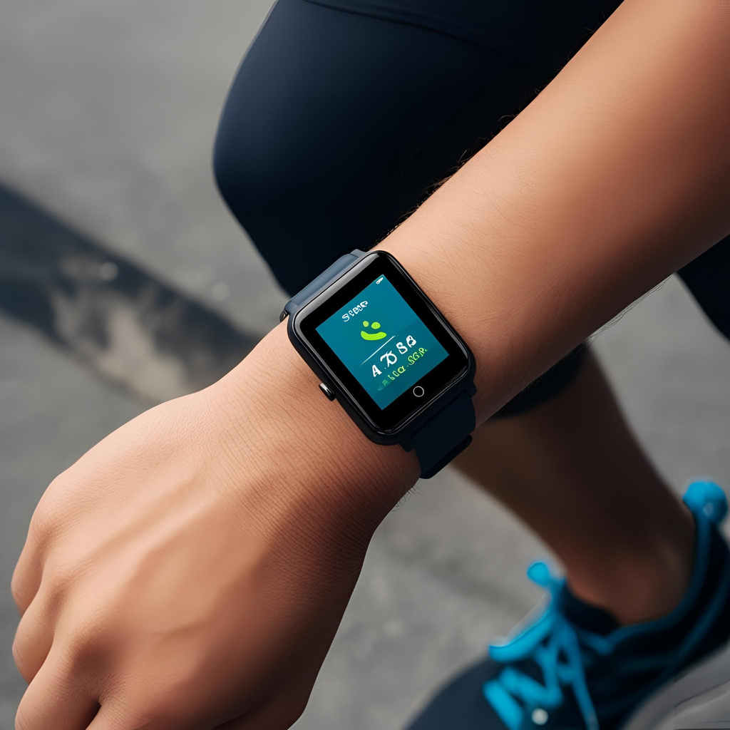


Slide 5




Progress Visualization with CSS/Charts
Data Visualization
Display progress visually through line charts, bar charts and pie charts.
Customization
Allow users to customize chart styles, colors and data points displayed
1.
2.

Slide 6


Weekly Goals and Summaries
Goal Setting
Enable users to set weekly
goals for water
intake, exercise
and calorie intake.
Progress Summaries
Provide weekly summaries
of user progress
towards goals , with
key metrics and
insights.

Slide 7


Daily Habit Tracker
Date:
April 12
Habit:
Drink 6+ glasses of water
Morning | Status | Afternoon | Status | Evening | Status
8:00 |  | 1:00 |  | 6:00
9:00 |  | 2:00 |  | 7:00
10:00 |  | 3:00 |  | 8:00
11:00 |  | 4:00 |  | 9:00
12:00 |  | 5:00 |  | 10:00
Summary:
Goal achieved!

Slide 8



Weekly Habit Tracker
Week:
April12-18
Date | Day | Wake up at 5 AM | Running | yoga | Exercise | Sleep for 8+ hours
April-12 | Sunday
April-13 | Monday
April-14 | Tuesday
April-15 | Wednesday
April-16 | Thursday
April-17 | Friday
April-18 | Saturday
 | Summary | 1/7 days | 5/7 days | 5/7 days | 4/7 days | 7/7 days

Slide 9
















Tech Stack and Tools
Front-End
HTML, CSS, JavaScript
Back-End
Node.js, Express.js
Database
Firebase

Slide 10
Implementation Approach
User Interface
Develop a user-friendly and
intutive interface for inputting data and viewing progress
1
Data storage
Implement a Firebase database to securely store
user data and activity logs.
2
Data visualization
Utilize CSS and charting libraries to create interactive and informative visualizations of user progress.
3

Slide 11
User Interface and UX Design
.
Information Architechture
Organise content and features logically for ease of navigation.
Visual Design
Create a visually appealing and motivating interface with clear typography and color schemes.
User Experience
Optimize user interactions for intutive data input, seamless navigation and engaging visualiasation

Slide 12
Challenges and Lessons Learned
1.
Data Security
Ensuring the secure storage and protection of user data.
2.
Charting Complexity
Choosing and implementing appropriate charting libraries for effective data visualisation.
3.
User Feedback
Continuosly gathering and incorporating user feedback to improve the app’s usally and functionally.

Slide 13
Conclusion and Future Enhancements
Success
Successfully developed a functional
health and fitness tracker application.
Future Enhancements
Integrate social features, AI-powered insights, and werable device compatibility.
1.
2.

Slide 14














Presention by Team POWER-RANGER
Presentation by team POWER-RANGER in Hackverse ‘Hackathon’ on topic
“Health&Fitness Tracker.
Team Members-
Srihan Kumar
Manik Mehta
Saloni Sinha

